Slide 1

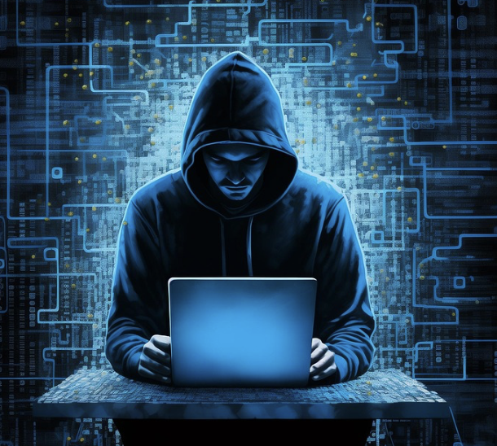
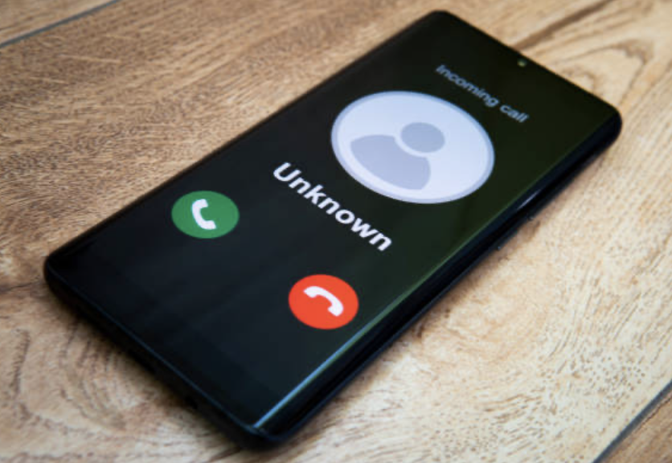
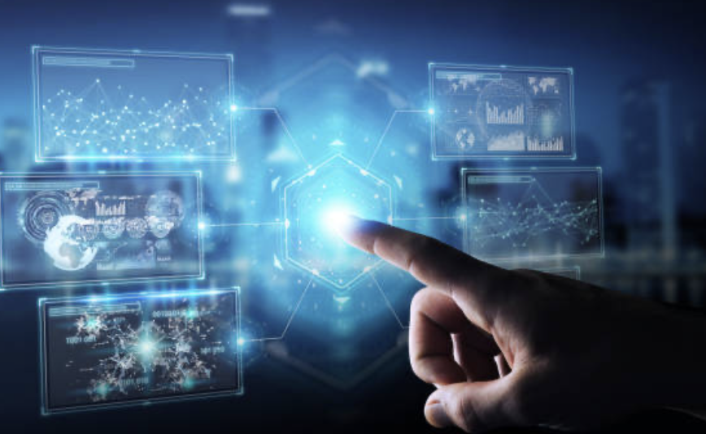
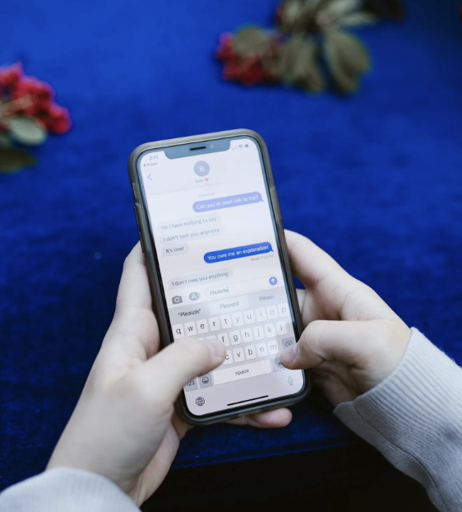
AI & Human IDENTITY Threats
WHO or WHAT is Really at the Endpoint?
On-Line Access By
Humans & AI Agents
Real-Time Communications from Humans & AI Deepfakes

Slide 2

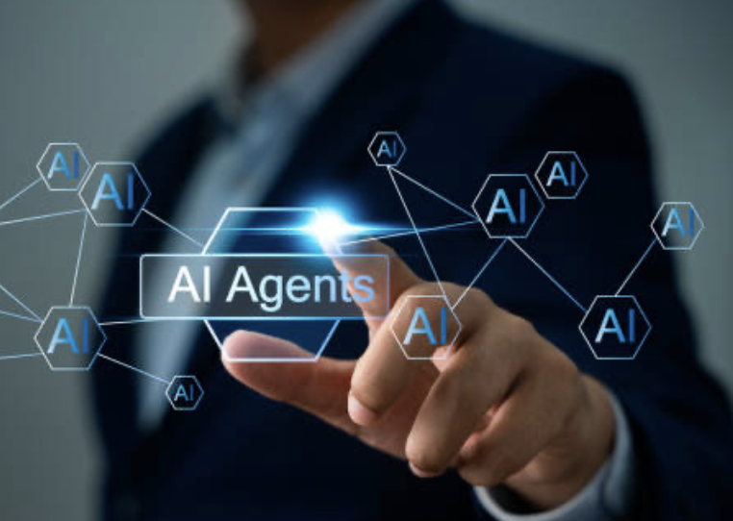
On-Line Access is the Front Door for Cyber Attacks
Data Breaches
Ransomware
Identity Theft
80-90% of ALL CYBERCRIMES
Start with Stolen Credentials
AI Agents are used by 85% of Enterprises, CAGR 46% over next
5 years
Learn How to Stop Stolen Credentials

Slide 3


AI Empowers Hackers for More Effective Social Engineering and Deepfakes
Fake Callers
(Humans or AI) are More Convincing
TextsSeem more Authentic
Customer Service and Help Desks can be Faked and/or Impersonated
Learn How to Stop Social Engineering and AI Deepfakes

Slide 4

Use AI’s Power to Stop AI’s Expanding Threats!
Unassailable IDENTITY
Up to 25 Identity Factors
Contextual Attributes
Dynamic Variables
AI-Driven Factor Selection by Risk and Use Case
Humans
AI Agents
Human-to-Human
Human-to-Agent
Human-to-Online
Agent-to-Human
Agent-to-Agent
Agent-to-Online
Learn More Now

Slide 5
